Slide 1
DOGO DESIGN
Screenshots

Slide 2
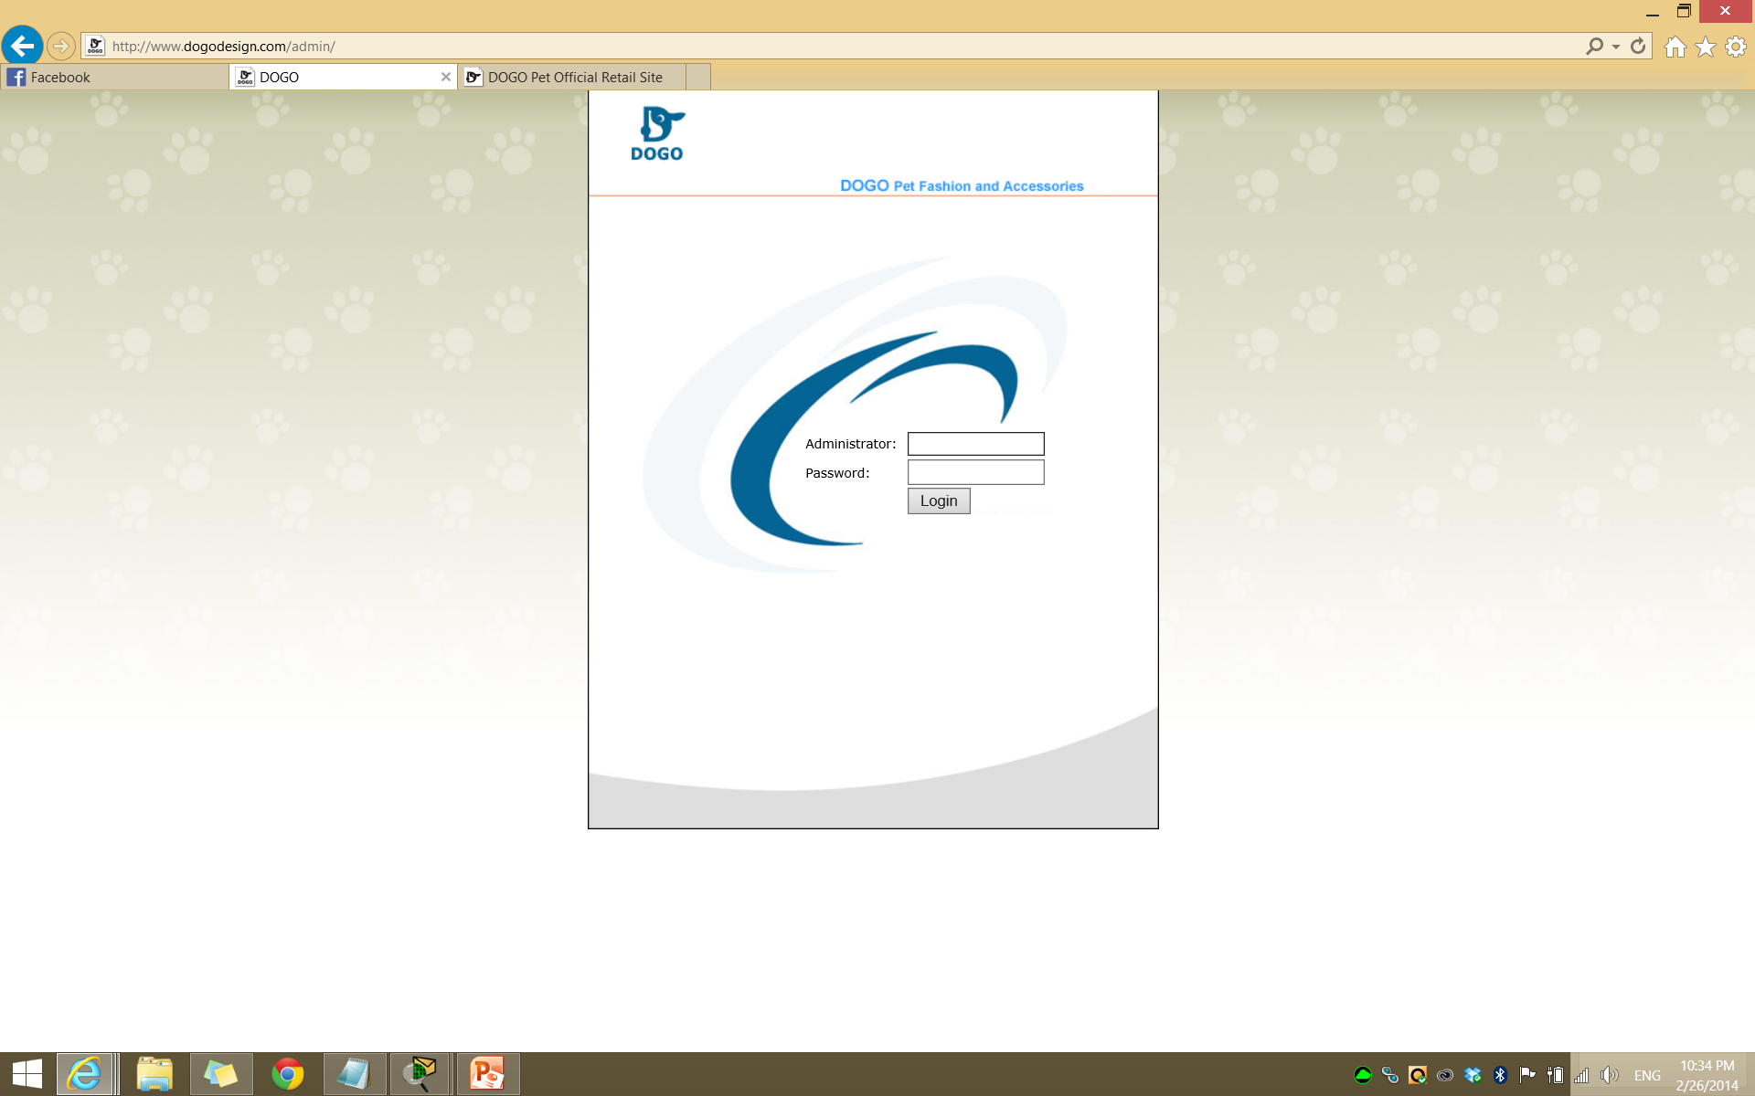

Slide 3
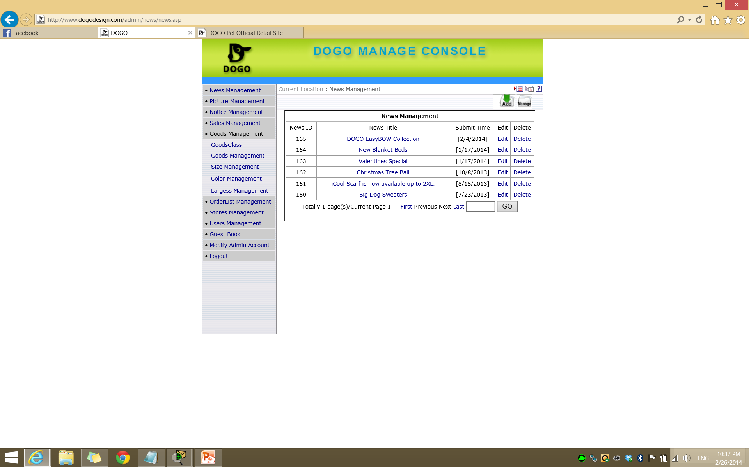
Notes:
News management

Slide 4
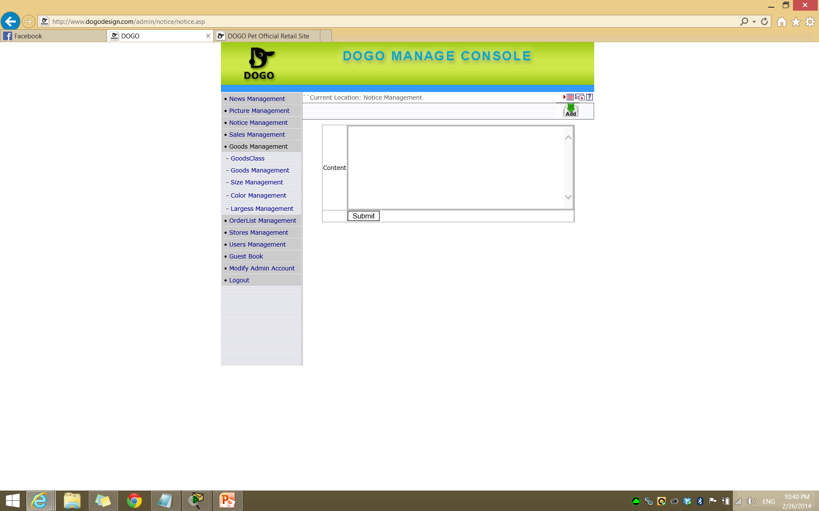
Notes:
Notice management

Slide 5
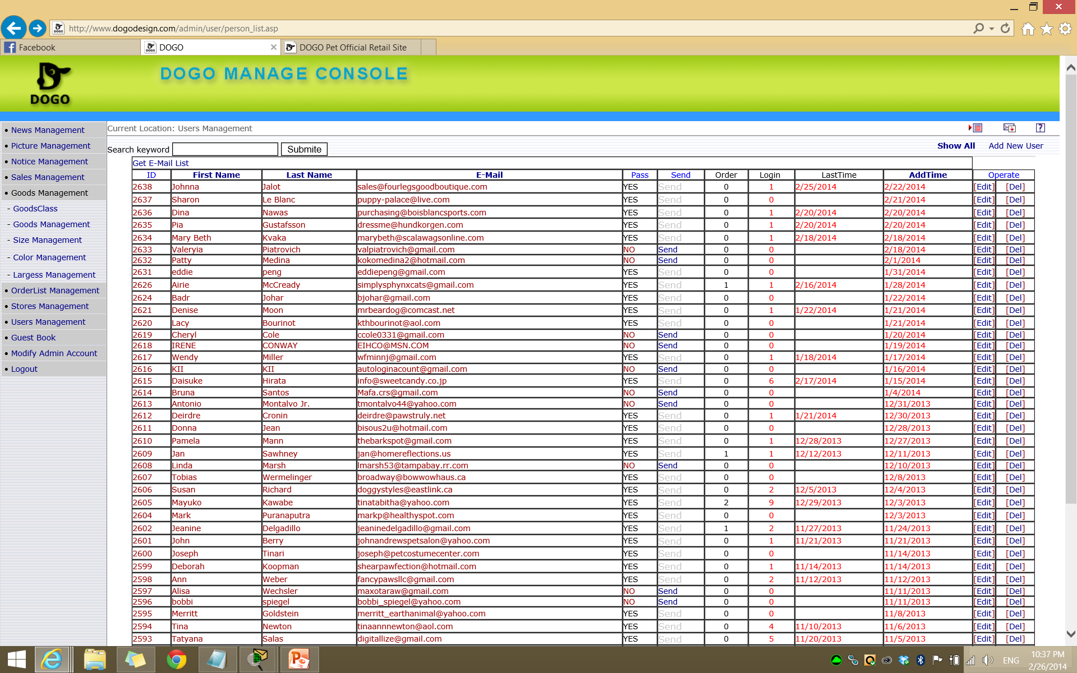
Notes:
Search screen – screen after login

Slide 6
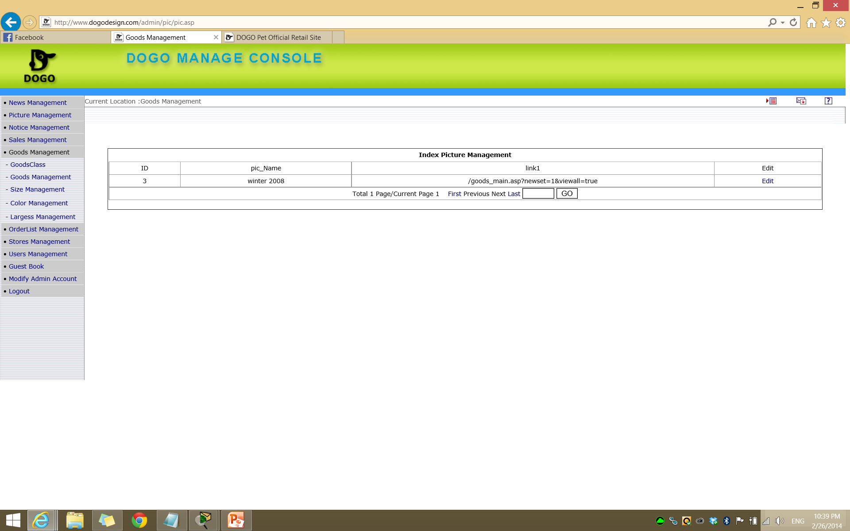
Notes:
Picture management

Slide 7
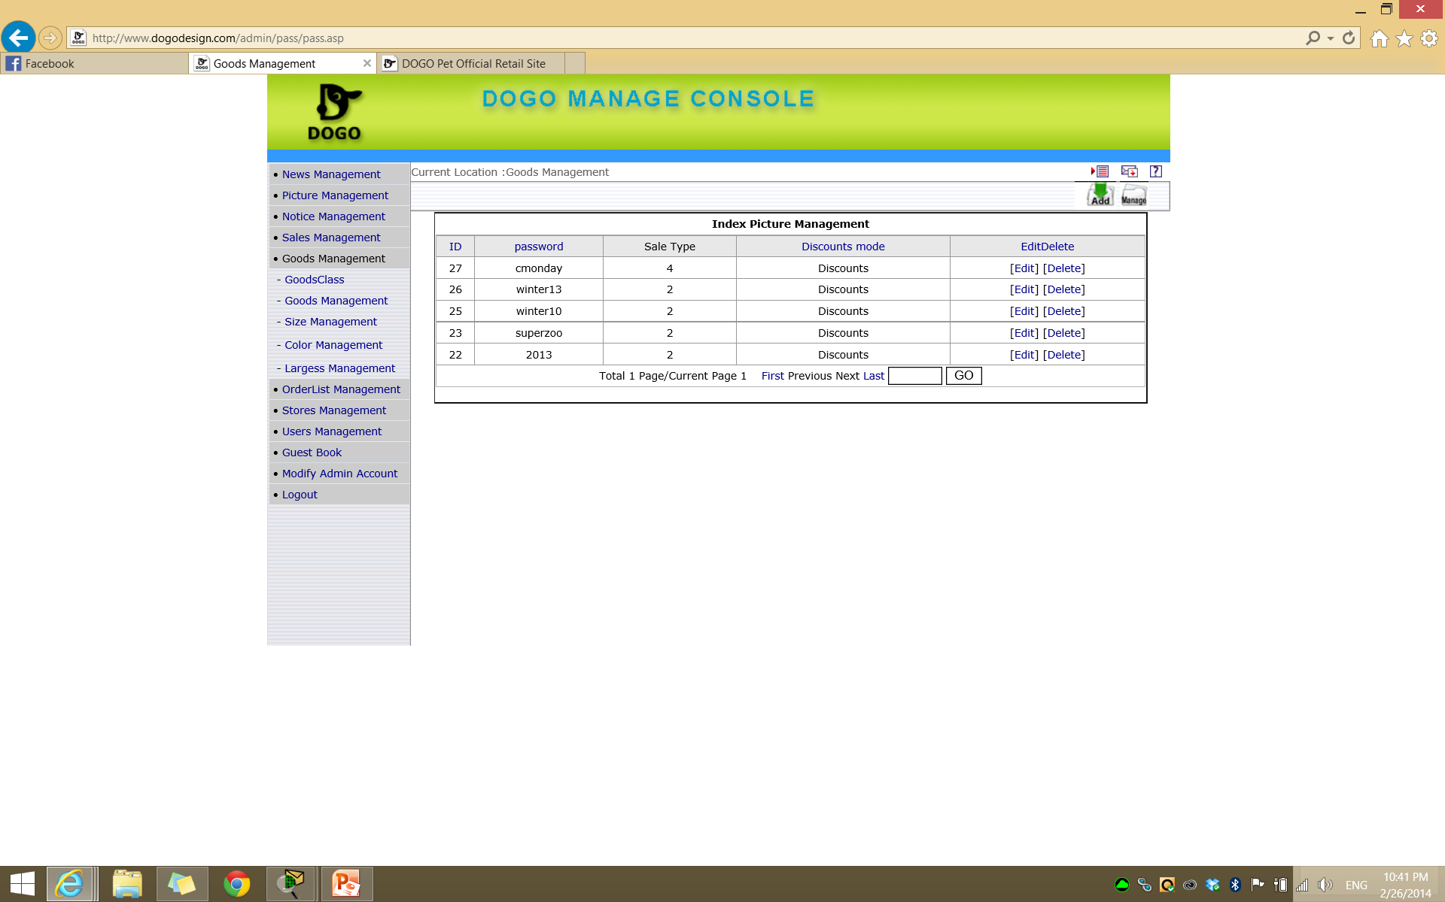
Notes:
Sales management

Slide 8
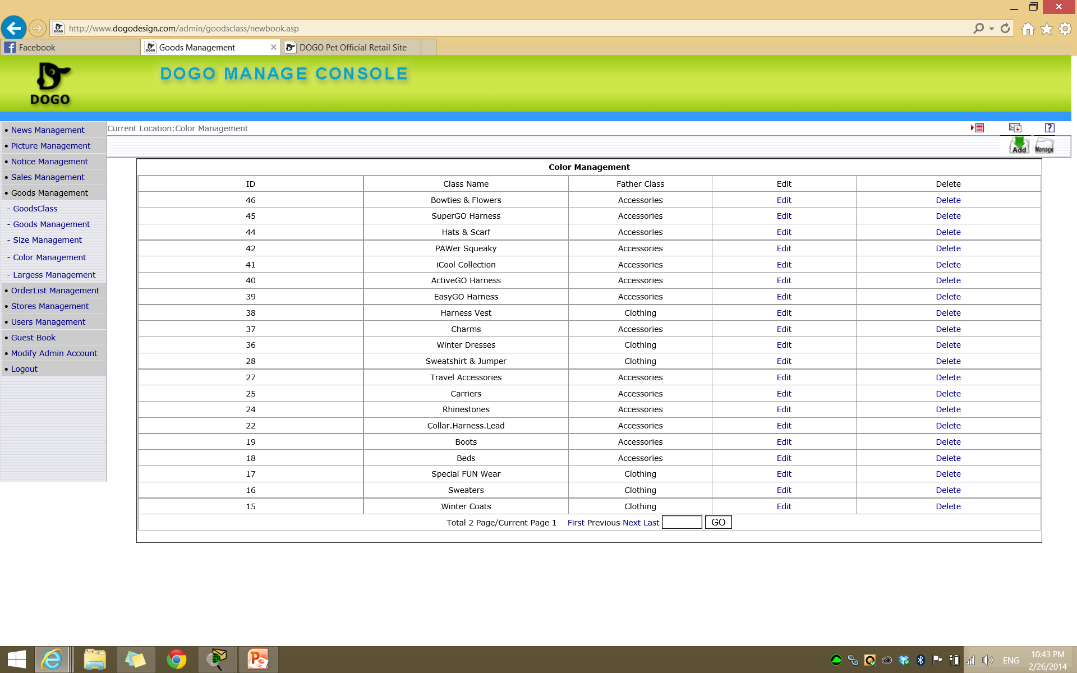
Notes:
Goods management - Goods class

Slide 9

Notes:
Goods Management – Goods management

Slide 10
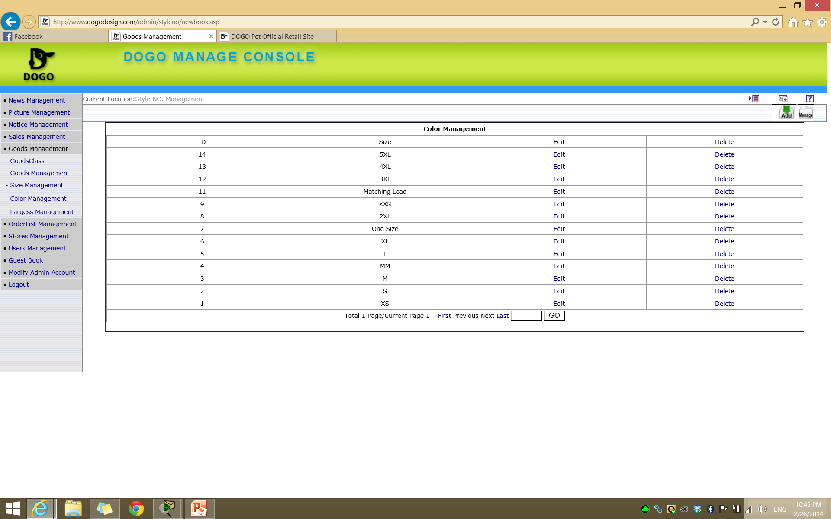
Notes:
Goods management- size management

Slide 11
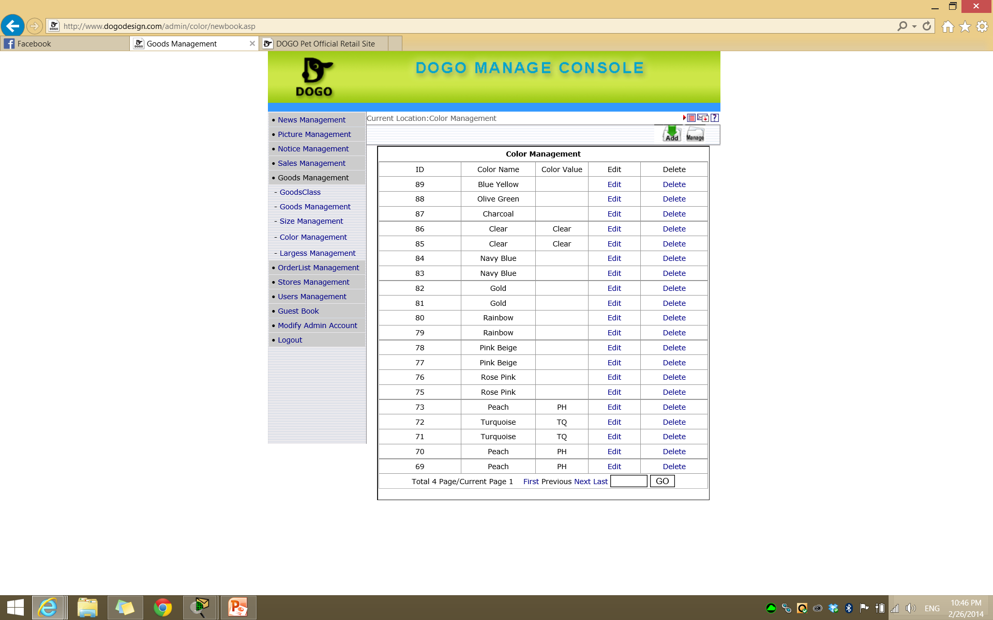
Notes:
Goods management – size management

Slide 12
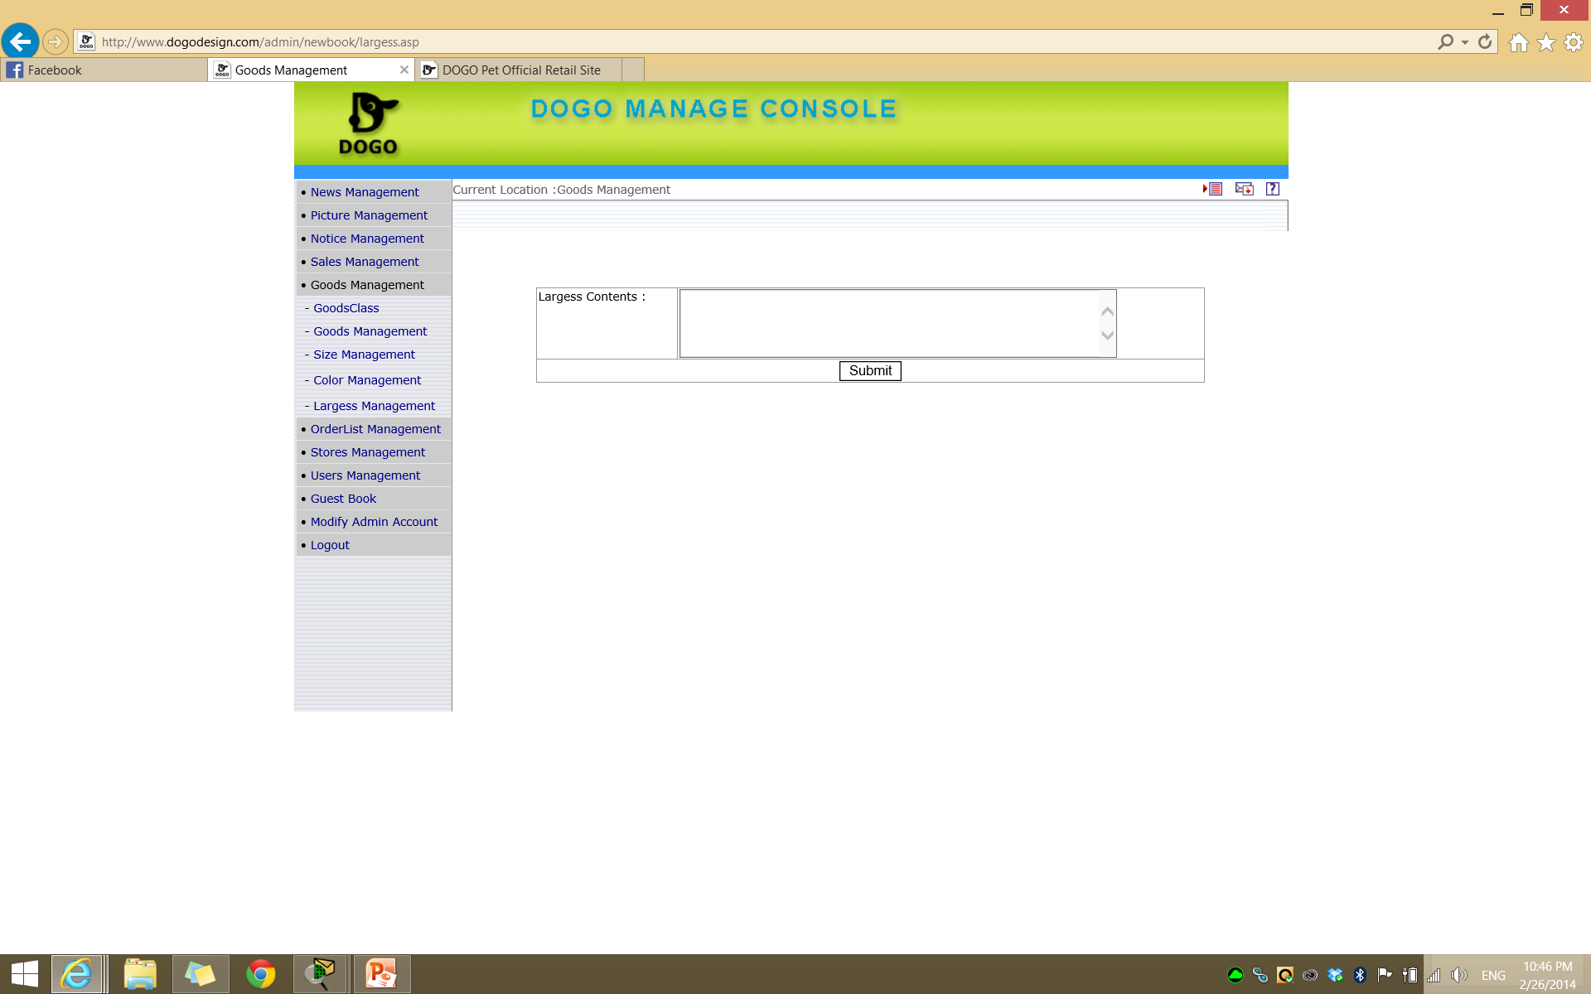
Notes:
Goods – management – largess management

Slide 13
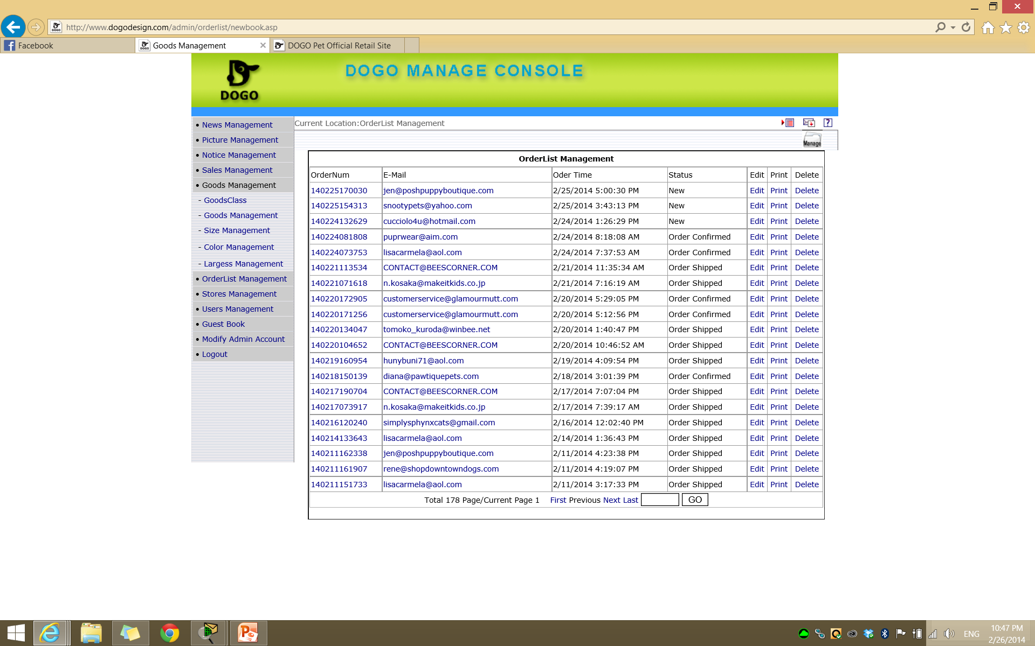
Notes:
OrderList Management

Slide 14
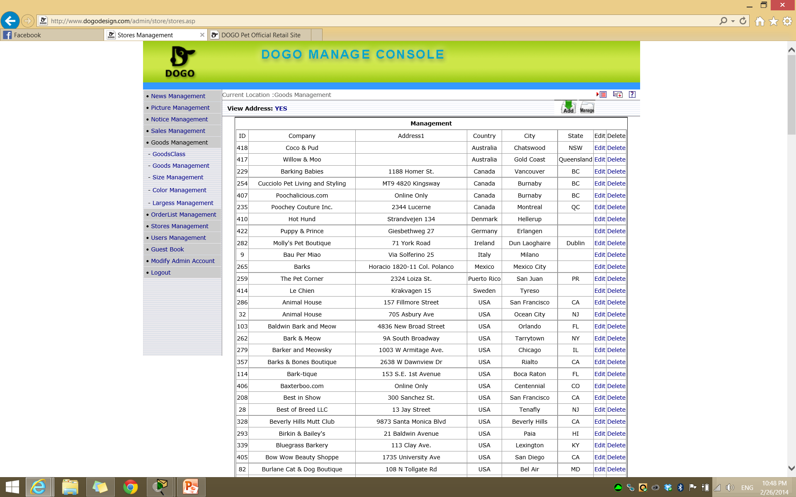
Notes:
Stores Managment

Slide 15

Notes:
Guest book

Slide 16
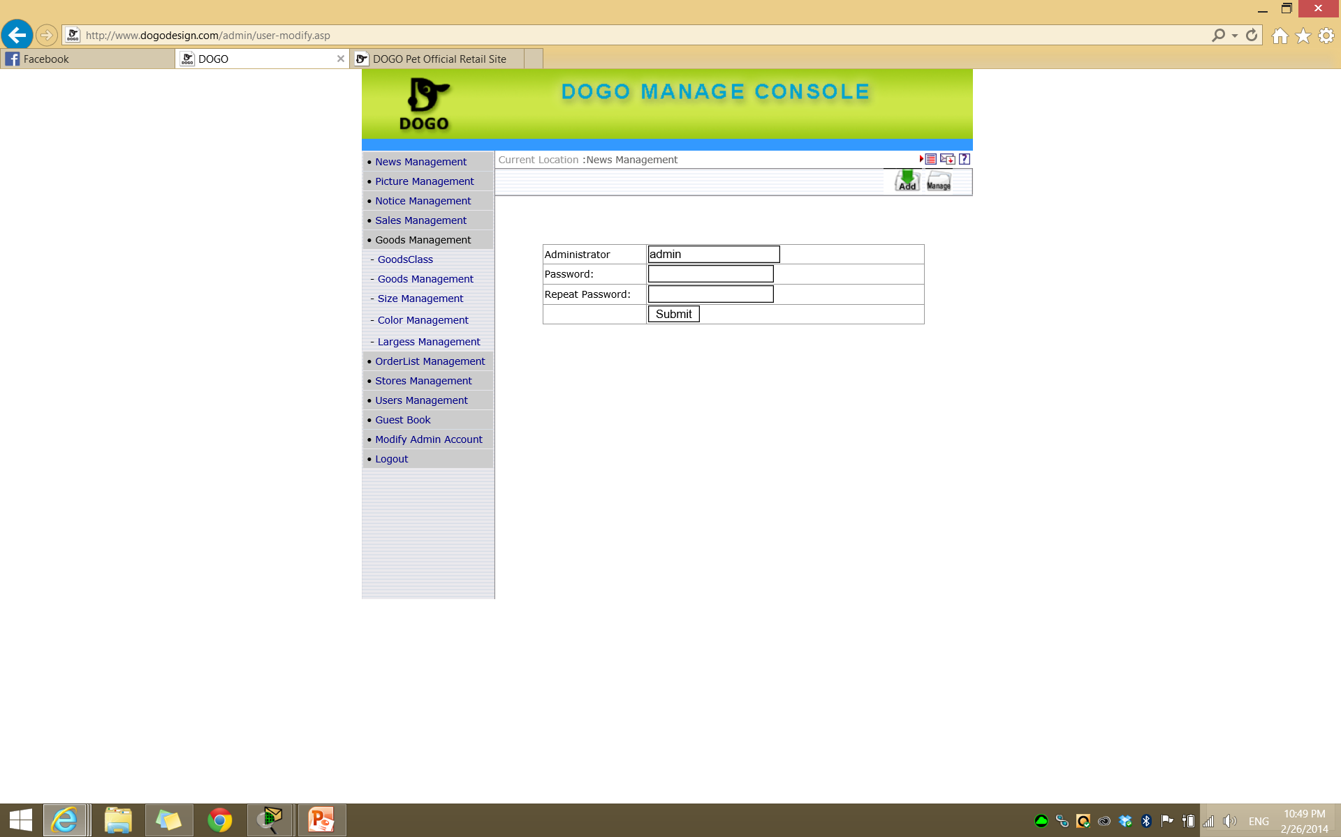
Notes:
Modify admin account

Slide 17
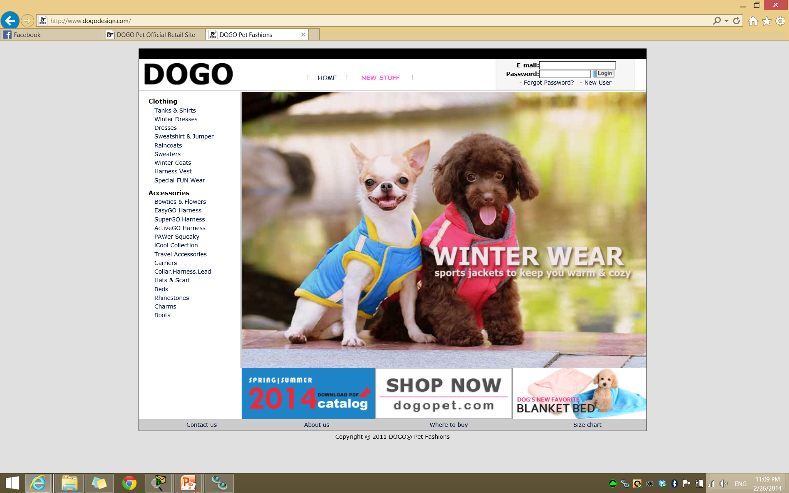
Notes:
Main screen – image needs to be same size as dogopet
They want to keep the vertical menu but main screen can skip it.. Add horizontal menu also. And reformat to match dogopet.

